Slide 1
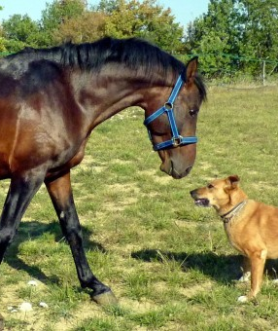
BRINGING THE ANIMALS IN
Interspecies learning on care, welfare and wellbeing
Balsall Heath City Farm
17th July 2024

Slide 2
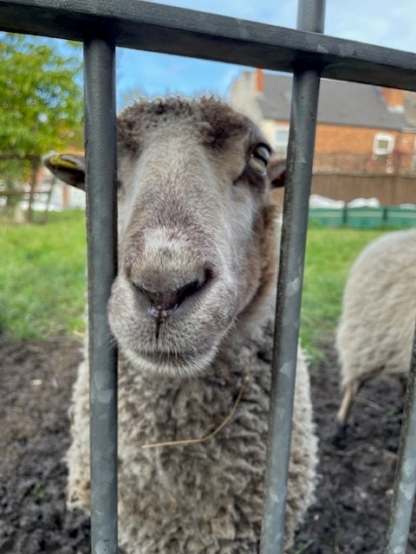
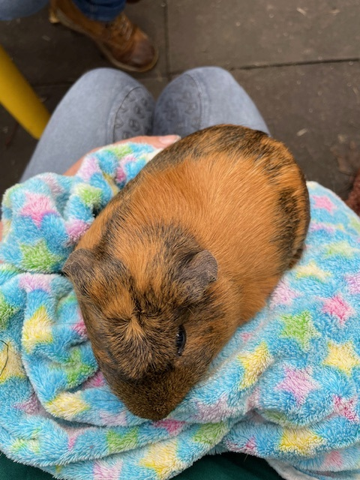
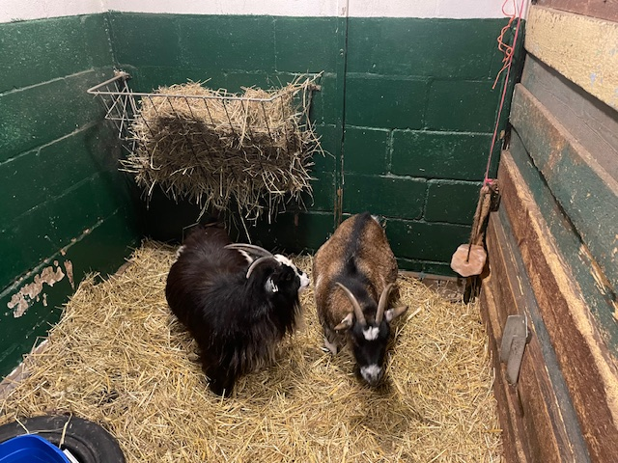
Aims of today
OR
Why are we here?!

Slide 3
Aims of today include…
Building relationships
Sharing own knowledge and motivations
Deepening own knowledge and understanding
Tools for practice
  ideas to apply in our own contexts, or practical learning
Planning future work

Slide 4
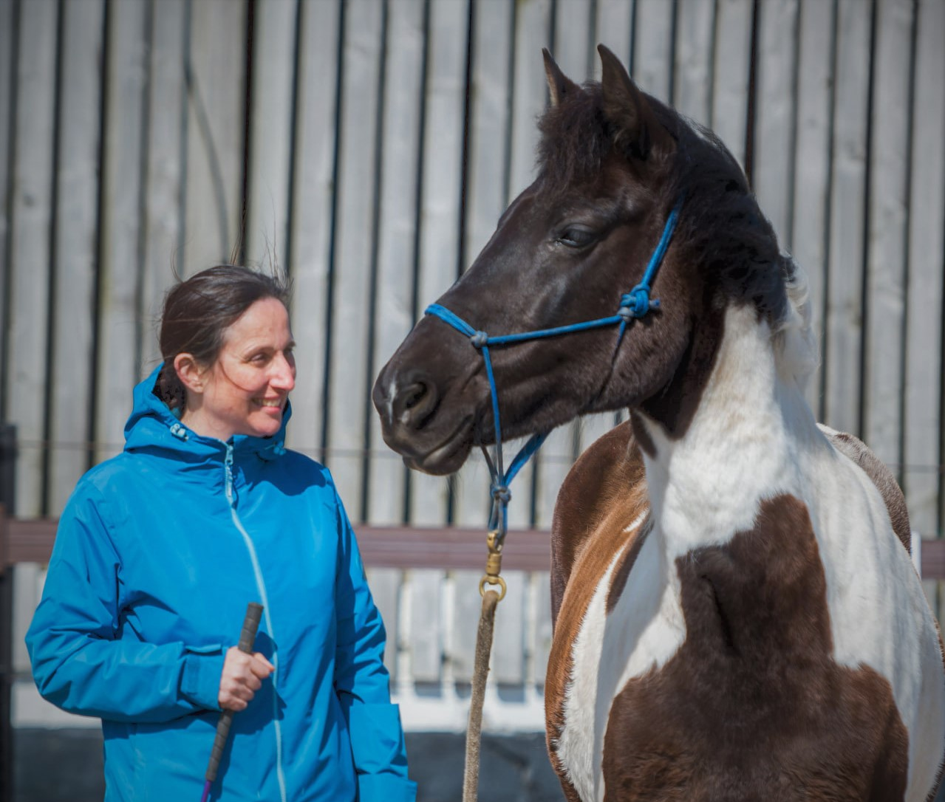
What might we mean by (i) interspecies perspectives? And (ii) interspecies learning
May be different definitions in the room depending on our different histories….
“… a social science of human and animal relations must attend to interspecies perspectives on social relations and attempt, if possible, to “see through the eyes” of humans and animals, and to imagine a world where “lions could speak”…”
Madden (2014, p. 280)

Slide 5
Human and non-human animal studies
Long history within western knowledge traditions of humans being understood as separate to nature, and from other animals
Reflected in how much of our education and professional training is organised
More recent moves to challenge this (e.g. through interdisciplinary work in ‘animal studies’, and the development of sub-disciplines such as ‘anthrozoology’)
For some there is also a political and existential reason to challenge this (e.g. an argument that climate crisis cannot be averted if humans are not prepared to engage with their place in the natural world).
Many traditional and indigenous / first people’s approaches to understanding human-non-human animal connectivity also challenges the ways in which humans have been positioned as separate to the natural world.

Slide 6
Check in: Interspecies Learning
How much opportunity have you had to engage in both human-focused and non-human animal focused learning?
  If you’ve experience of both human-focused and non-human animal focused has this been in separate environments?
What gaps have there been in previous learning opportunities?
  (which might highlight opportunities for producing something else in the future!)?
Do people build their own ‘interspecies learning’ environments?
  And is this something you support or have had supported for yourself?
    Links to ‘heutagogy’ – self determined learning

Slide 7
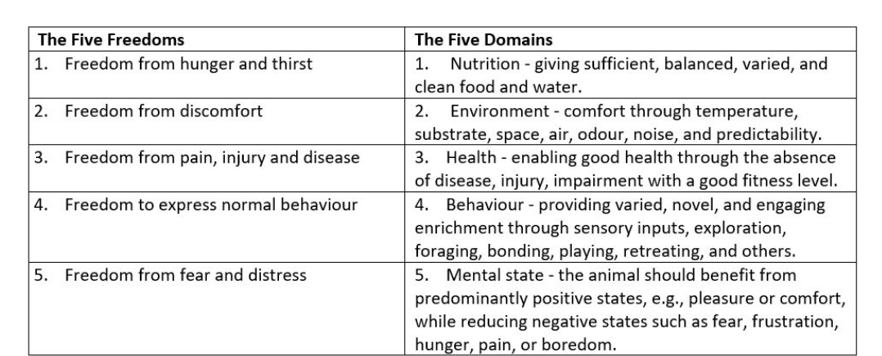
Learning from animal welfare
From Sopel, D. (2021)

Slide 8
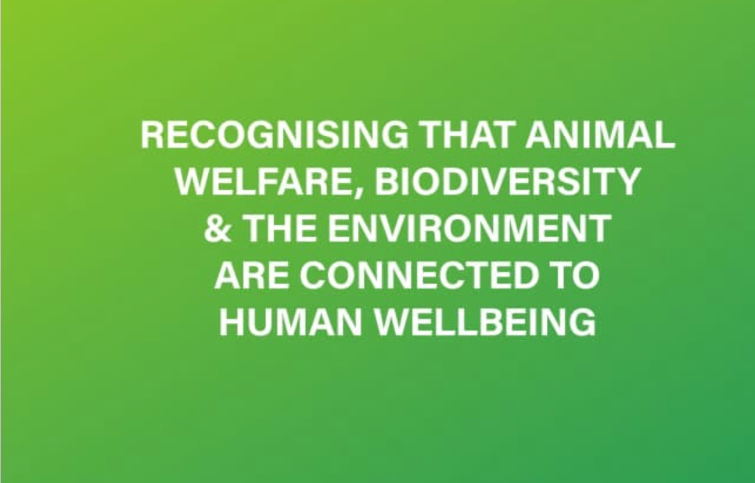
‘One Welfare’
https://www.onewelfareworld.org/
From their FAQs:
“One Welfare describes the interconnection between animal welfare, human wellbeing and their physical and social environment as important elements to consider in the elaboration and implementation of policies and activities related to each of these aspects. A One Welfare approach promotes the direct and indirect links of animal welfare to human welfare and environmentally friendly animal-keeping systems. One Welfare “fosters interdisciplinary collaboration to improve human and animal welfare internationally”.

Slide 9
Care, Welfare and Wellbeing:
CARE | Human | Non-human | Interspecies?
VIRTUE | Care as a virtue, a feature of an individual’s character | Can non-human beings develop a virtue of care? | Is care as a virtue something we can produce together, human and non-human?
ORIENTATION | Care as an orientation – for example caring about a specific group (in terms of social justice) or person (a specified other) | Can non-human beings express caring about others? | Is care as an orientation something we can produce together?
ACTIVITY | Care as an activity - the provision of resource to directly address needs and preferences (caring for) | Can non-human beings directly address needs and preferences? | Is care as an activity something we can produce together.

Slide 10
Care, Welfare and Wellbeing:
WELFARE | Human | Non-human | Interspecies?
A STATE OF BEING (POSITIVE OR AVOIDANCE OF NEGATIVE CONDITIONS) | ‘Faring well’ (similar to ‘being well’ as per wellbeing) | Five Domains of Animal Welfare: a model encompassing both survival and thriving | What can we learn about the intersection of conditions that can enhance or risk human and non-human animal welfare?
CONDITIONS RESPONDED TO THROUGH POLICY ADMINISTRATION | Administrative approaches to meeting needs in populations (‘welfare’ as a pejorative term for social security) | e.g. legislation and required practices that govern farming, and the keeping of animals. | How does legislation support the wellbeing of humans and non-humans ‘working together’ for welfare and wellbeing?

Slide 11
Care, Welfare and Wellbeing
WELLBEING | Human | Non-human | Interspecies?
HAPPINESS | Hedonic, in the moment versus ongoing flourishing | Can happiness be relevant to non-human animals? | Can we support each others’ happiness?
VIRTUE EXPRESSION | Being well as being able to be good | Do animals express ‘virtue’? | Can we ‘co-produce’ good in the world?
PREFERENCE SATISFACTION | Meeting wants | Do animals seek preference satisfaction? | Can we organise to meet each others’ preferences?
NEEDS SATISFACTION | Meeting needs | Is needs satisfaction necessary and sufficient for animal wellbeing? | Can we organise to meet each others’ needs?
JUST DESERTS | Receiving what is due | Do animals seek recompense, do they deserve recompense? | Can we each benefit from rewards e.g. from our ‘labour’ or our relationships?
See Fitzpatrick (2011)

Slide 12
To what extent are we ‘speaking the same language’ or thinking differently when we consider care, welfare and wellbeing [from non-human animal and human perspectives]?

Slide 13
Horses, dogs, small furries (and others…)
“And at the end they're always extremely happy, because volunteers always bring carrots and apples for the ponies, so they're quite happy. So, no problems there. And the children, yeah, they're just happy to be there as well. So yeah, it's all good, you know, as I say, you just have to be aware. So, it’s good if you have got a little bit of knowledge, of either teaching children or of riding horses, or being around horses, not necessarily riding them, but being around horses. And having an empathy with them. ”
  RDA Coach (in research work ongoing at the University of Birmingham)

Slide 14
Horses, dogs, small furries (and others…)
“Bailey is still my service dog, attentive to my emotions, needs and whereabouts, his very presence helping to mediate between me and the ableism I encounter when we go on our daily walks together. And I gladly embrace being his service human as much as I can. … Two vulnerable, interdependent beings of different species learning to understand what the other one needs. Awkwardly and imperfectly, we care for each other”
  Sunaura Taylor on her ‘service dog’ Bailey, as he adjusts to his own impairments.
  Taylor (2017, p. 223)

Slide 15
Horses, dogs, small furries (and others…)
“Last summer. One afternoon, three young ladies ….about 16, came here. … I then said would you like to see the Guinea pigs? Oh yes, please. So there they are doing videos of Guinea pigs, selfies, …all the rest of it. And it's all screaming and everything and giggling…. And then after about 20 minutes or so. Maybe half hour and one of them was sat there. Her phone was beside on the bench. She got a Guinea pig on her stomach, looking her in the face, and she's sitting there stroking it. And she, in her own little world? Yes. And she and her friends, two friends, were very similar. …all of a sudden that they had a situation where nobody was demanding anything of them and they could just wind down and that was it”.
  Volunteer, City Farm

Slide 16
Horses, dogs, small furries (and others…)
“Oh, you've got my husband - touched the rabbits and the Guinea pigs - so he enjoys them. And he was talking to the man about turkeys and the fact that one died a week ago. And he said that that “if you were in where I’m from (Eastern Europe), I would give you one straight away” because we have that - we are like 3000 kilometres away, so we can't help you but yeah.
  Mother visiting farm event with husband and children

Slide 17
What is shared and what is different in relation to work involving different species (e.g. horses, dogs and small furries)?
Are there any wellbeing outcomes which might be fundamentally shared across all types of animal assisted/animal supported wellbeing?
Are the care, welfare and wellbeing needs of animals we engage with for human wellbeing purposes very different?

Slide 18
Overcoming barriers to interspecies wellbeing
Examples of barriers:
Professional (e.g. lack of shared professional identity across sectors contributing to interspecies wellbeing)
Material (e.g. financial resourcing for services)
Cultural (e.g. anthropocentric ideas that humans have nothing to learn from animals, animals as our servants)

Slide 19

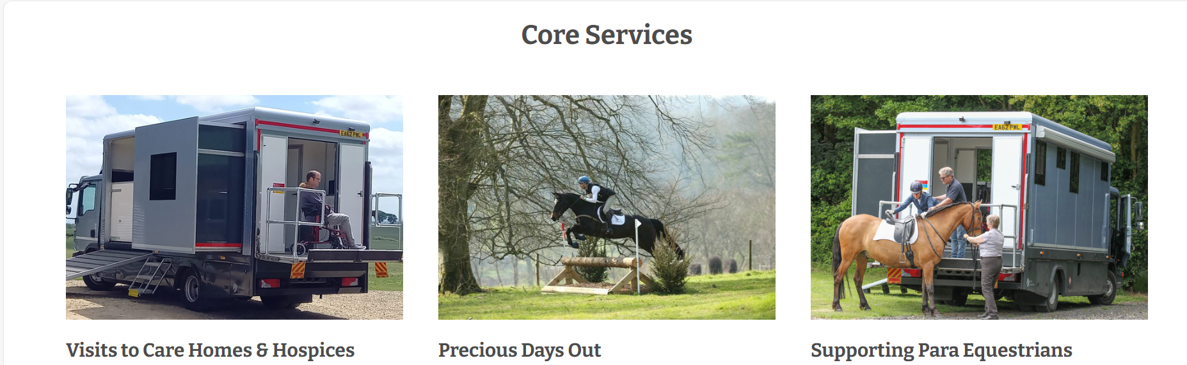
Overcoming barriers to interspecies wellbeing
www.happinesshorsebox.co.uk

Slide 20
Sharing priorities for future work
EACH PERSON TO IDENTIFY FOR THEMSELVES
One action or opportunity that would support producing interspecies wellbeing (from your perspective)

Slide 21
Follow up
Document from today will be shared with all participants once written up.
Potential to invite people to an email list for supportive work network going forward.
Anything else?
With thanks … Farm time!

Slide 22
Resources
Madden, R. (2014) Animals and the Limits of Ethnography, Anthrozoös, 27:2, 279-293, DOI: 10.2752/175303714X13903827487683
Fitzpatrick, T. (2011) Welfare Theory: An Introduction to the Theoretical Debates in Social Policy, Bloomsbury.
Sopel, D. (2021) Moving to the 'Five Domains' model for assessing animal welfare (wcl.org.uk) (Accessed July 15th 2024)
Taylor, S. (2017) Beasts of Burden: Animal and Disability Liberation, The New Press.

Slide 23
Keeping connected….
Harriet Clarke, Associate Professor,
School of Social Policy and Society
University of Birmingham
Email: h.clarke@bham.ac.uk
LinkedIn: www.linkedin.com/in/harriet-elena-clarke/
X/Twitter: @hazzyc

